Slide 1
DATA SCIENCE Intro to Data Science

Slide 2
I. What Is A Data Scientist? II. Data Science Workflow
AGENDA

Slide 3
I. What is A Data Scientist?
INTRO TO DATA SCIENCE

Slide 4
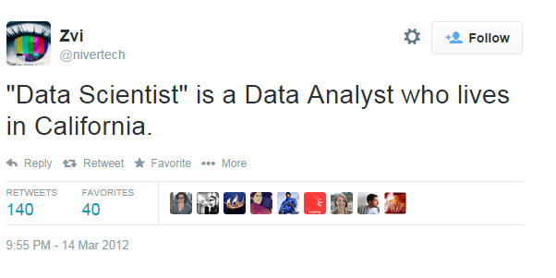
WHAT IS A DATA SCIENTIST?

Slide 5
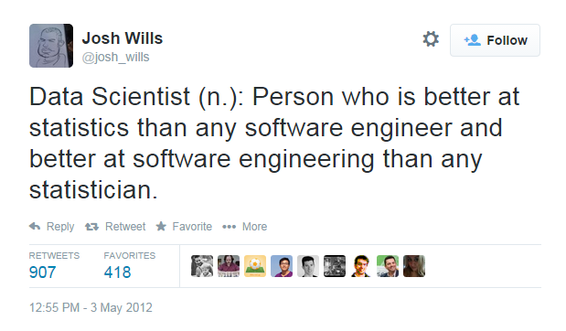
WHAT IS A DATA SCIENTIST?

Slide 6
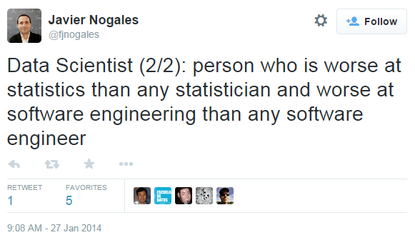
WHAT IS A DATA SCIENTIST?

Slide 7
What Is your definition?
WHAT IS A DATA SCIENTIST?

Slide 8
WHAT IS A DATA SCIENTIST?
“Data Scientists are people with some mix of coding and statistical skills who work on making data useful in various ways.”
Data Scientist Type A (for Analysis):
Primarily concerned with making sense of data or working with it in a fairly static way.
Similar to a statistician, but knows all the practical details of working with data that aren't taught in statistics: data cleaning, dealing with large data sets, visualization, domain knowledge, etc.
Source: https://www.quora.com/What-is-data-science/answer/Michael-Hochster

Slide 9
WHAT IS A DATA SCIENTIST?
“Data Scientists are people with some mix of coding and statistical skills who work on making data useful in various ways.”
Data Scientist Type B (for Building):
Some statistical background, but strong coder or software engineer.
Primarily concerned with using data “in production”: building models which interact with users (by giving recommendations, for example).
Our course is focused primarily on Type A.
Source: https://www.quora.com/What-is-data-science/answer/Michael-Hochster

Slide 10
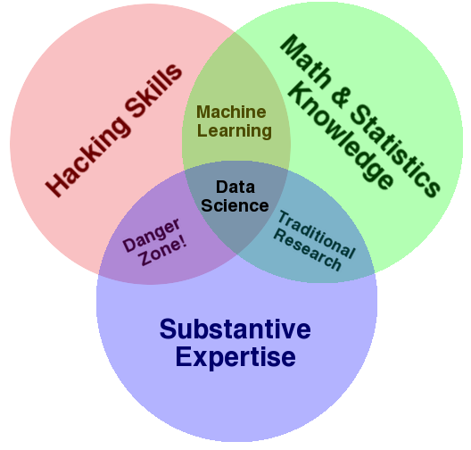
WHAT IS A DATA SCIENTIST?
Wide variance in terms of skillsets: many job descriptions are more appropriate for a team of data scientists!
Source: http://drewconway.com/zia/2013/3/26/the-data-science-venn-diagram

Slide 11
Ii. data Science Workflow
INTRO TO DATA SCIENCE

Slide 12
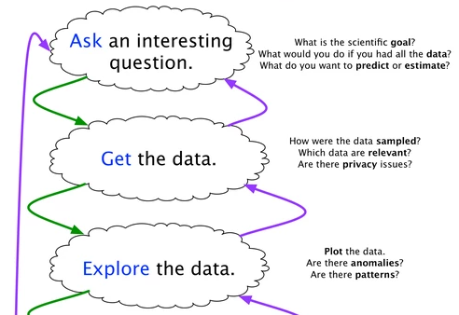
The data Science WORKFLOW

Slide 13
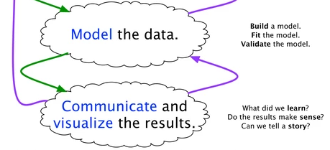
The data Science WORKFLOW
Source: https://www.quora.com/What-is-the-work-flow-or-process-of-a-data-scientist-analyst-and-what-tools-do-you-use-for-this/answer/Ryan-Fox-Squire

Slide 14
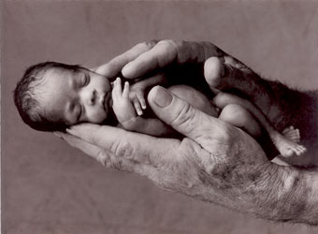
Example #1: Predicting Neonatal Infection
Problem: Children born prematurely are at high risk of developing infections, many of which are not detected until after the baby is sick
Goal: Detect subtle patterns in the data that predicts infection before it occurs
Data: 16 vital signs such as heart rate, respiration rate, blood pressure, etc…
Impact: Model is able to predict the onset of infection 24 hours before the traditional symptoms of infection appear
Image: http://www.babycaretips4u.com/wp-content/uploads/2014/03/premature-baby.jpg
Case Study: http://www.amazon.com/Big-Data-Revolution-Transform-Think/dp/0544002695

Slide 15

Example #2: Automating Government Paper-Pushing
Problem: Processing disability claims at the Social Security Administration is a time-intensive process, with many claims taking over 2 years to adjudicate
Goal: Automate the approval of a subset of the “simplest” disability claims
Data: Free text in the claims form
Impact: Able to fully automate 20% of the simplest claims. Rating accuracy of the algorithm is higher than the average claims examiner.
Case Study: http://datamininglab.com/images/case-studies/ERI_Text_Mining_SSA_Claims_for_Disability_Approval.pdf

